Slide 1
Brain Implant with Subcutaneous Wireless Relay and External Wearable Communication and Power Device
US 2021/0007602, 1/14/2021
3/23/2024

Slide 2
Outline
Goal: Describe a BMI implant with wireless relay communication + externally worn power device
Embodiments:
Views of BMI implants
Human head with alternative system of BMI implants
Implant with ribbon cable extending below it
Exploded view of implant
Cross section of implanted electrodes
Base station

Slide 3
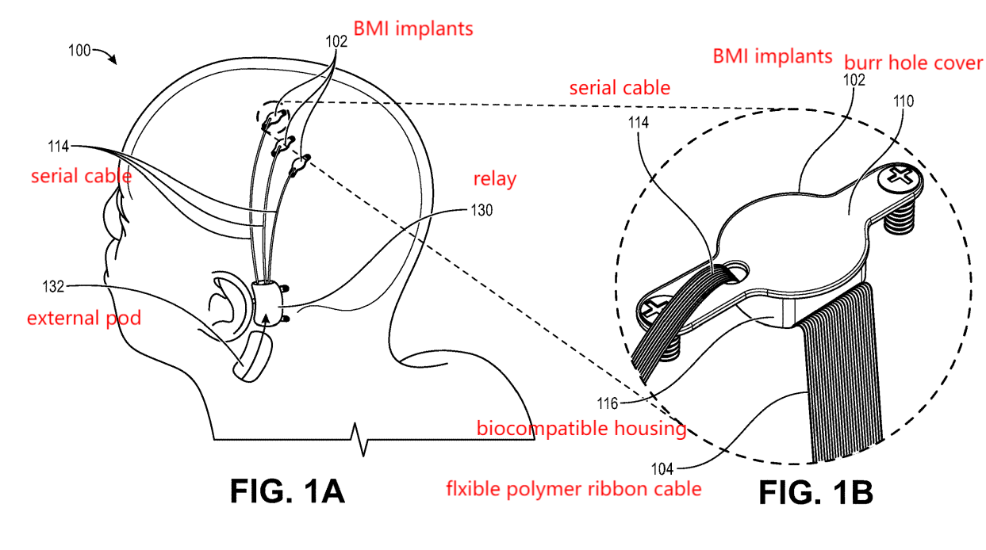
Perspective Views of BMI Implants

Slide 4
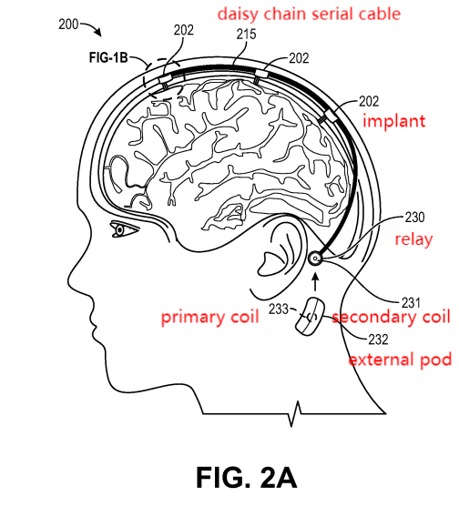
Human Head with Alternative System of 3 BMI implants

Slide 5
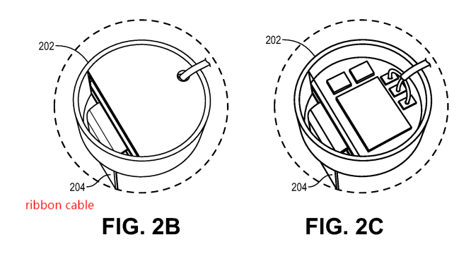
Implant with Ribbon Cable Extending Below It

Slide 6
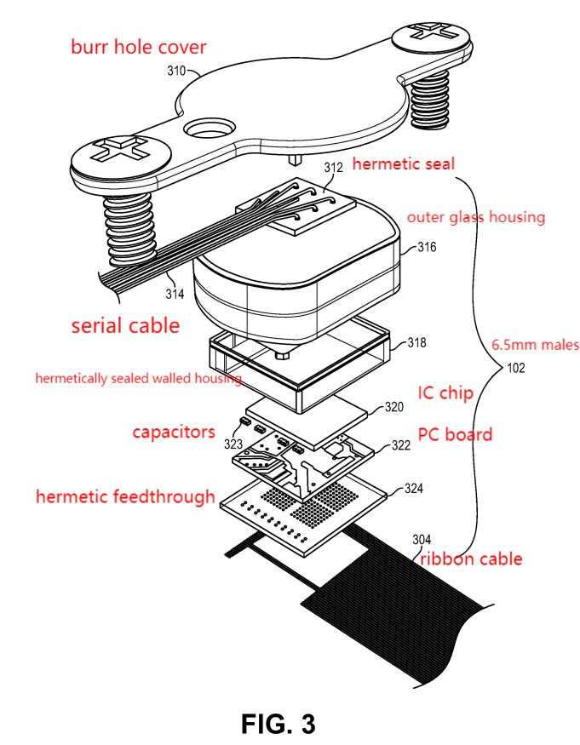
Exploded view of implant

Slide 7
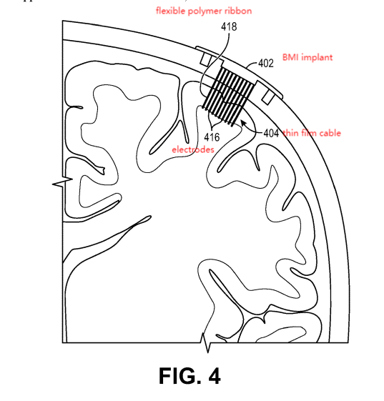
Cross section view of implanted electrodes

Slide 8
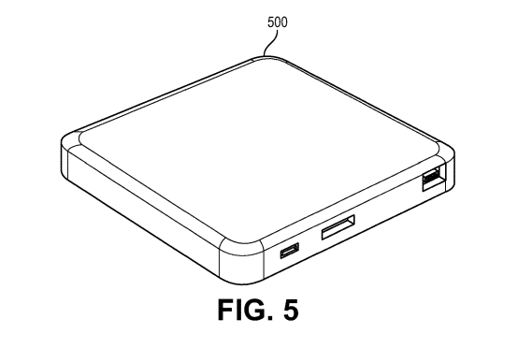
Base station

